Slide 1

Smart Classroom using IoT and Android Application
Department of ___CSE-IoT________
(Supervisor: Mr. Utsav Malviya)
Group Members
Name of Member | Roll Number | Role
Shiv Shikhar Sinha | 2001331550033 | Team Leader, Software
Ritik Kumar Yadav | 2001331550030 | Hardware
Varun Kumar | 2001331550038 | Documentation

Slide 2

Index
Introduction
Literature Survey/Existing System(In Tabular Form with references)
Problem Statement
Proposed Methodology (Including DFD/ER Diagrams/ Usecases)
Hardware /Software Requirements
Live Project Progress
Research Paper Status
Future Action Plan

Slide 3
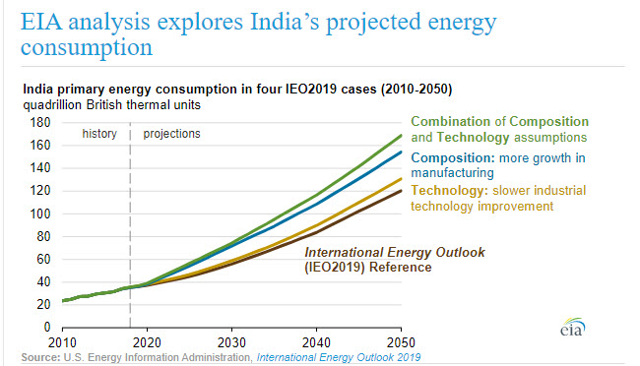
Introduction
The current system of managing classrooms is often manual and outdated, which results in a significant amount of energy being wasted due to unnecessary lighting, heating, and cooling.
In a typical classroom, lights, fans, and other electrical devices are turned on and off manually by teachers and students. This process is often inefficient, as students may forget to turn off lights or fans when leaving the classroom, leading to unnecessary energy consumption. Furthermore, the manual control of devices does not allow for precise adjustments based on real-time data, such as changes in the number of students in the room or changes in the outdoor temperature.
In terms of energy savings, implementing a Classroom Automation Project using IoT can result in significant reductions in energy consumption. Studies have shown that implementing an IoT-based smart system can reduce energy consumption by up to 30%. This can translate into substantial cost savings for educational institutions, which can then be reinvested in other areas.

Slide 4
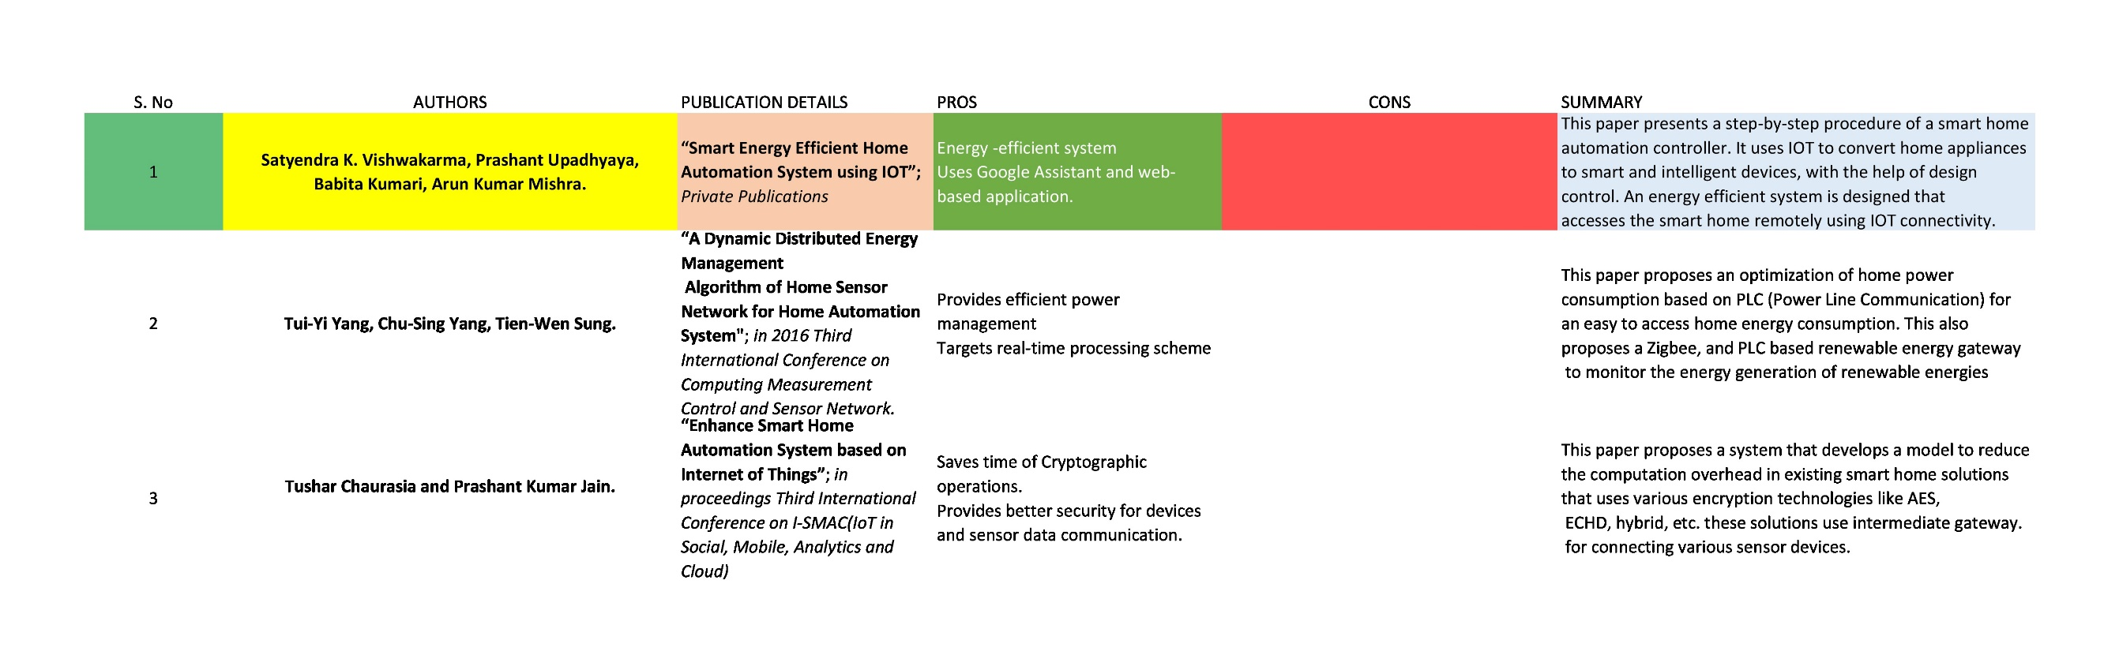
Literature Survey

Slide 5
Problem Statement
Automating Smart Classroom using NodeMCU and Android App via Google Firebase.
Reducing wastage of Electric Energy and making the operating of devices easier.
Improving the Learning Environment by monitoring student’s activities.

Slide 6
Aim
Our Aim for this Project are:
Controlling and Monitoring Appliances
Building a Scalable Android App to integrate all the Smart Features with controls
Monitoring Students Activities in a Classroom
Share Insights with the Admin.

Slide 7
Proposed Methodology
Existing devices like fans, lights etc.
Other Sensors
To Build an innovative solution that automates various aspects of a classroom, including devices such as fans, lights, and projectors, while also monitoring student performance and promoting sustainability by saving electricity.
The system includes an IoT device consisting of various sensors and microcontrollers ( like NodeMCU ) connected to existing devices in the classroom and an Android App that provides control and monitoring of automation to administrators, including teachers and class representatives. The system is accessible with an internet connection and can be controlled and monitored from anywhere in the world.
DHT11
NodeMCU
Google Firebase
Android Application

Slide 8
Highlights of the Project
Innovative Solution for a Classroom
Highly Scalable and Customizable
Saves Time, Administrative Workload and Electricity
Provides valuable insights to admins.
Ensures Security and Privacy of Data
Can be integrated with other platforms.
Fire detection and Intruder Detection and Notification.

Slide 9
Tools & Technology
Hardware Software
NodeMCU
Jumper Wires
Breadboard
Led Lights
DHT11 Temperature & Humidity Sensor
4 Channel Relay Module
Fire Sensor
PIR sensors
Android App - ReVamp
Google Firebase
Android Studio
Arduino IDE

Slide 10
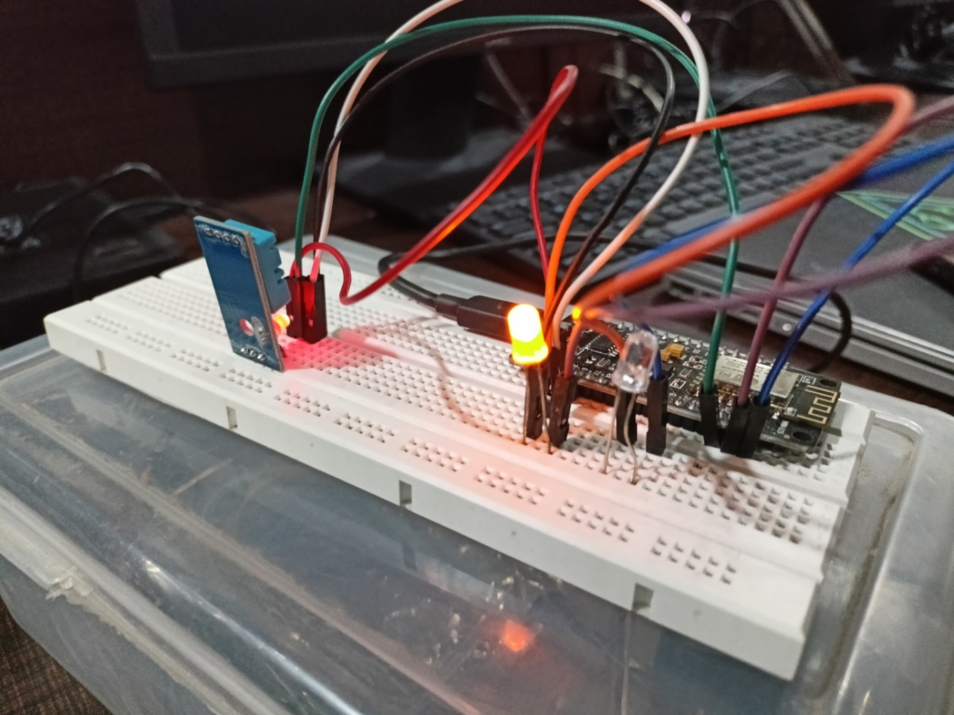
Live Project Progress – IoT Device

Slide 11
RESEARCH PAPER STATUS
Research paper in its initial stage.
Report drafting Completed.
Synopsis drafting Completed.

Slide 12
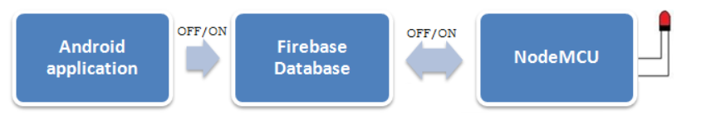
Model Working
Working principle of the project (Android app, Google Firebase, and Node MCU)
In this project, there are three main components are used an Android app, Firebase database and, Wi-Fi Node MCU with Arduino.
The Android app sends the serial data 1 or 0 to the Firebase database. The Firebase database interacts with Wi-Fi NodeMCU and this NodeMCU acts on the basis of data received from Firebase Database. If NodeMCU receives serial data 1, it turns ON the LED, and if NodeMCU receives serial input 0 then it turns OFF the LED.

Slide 13
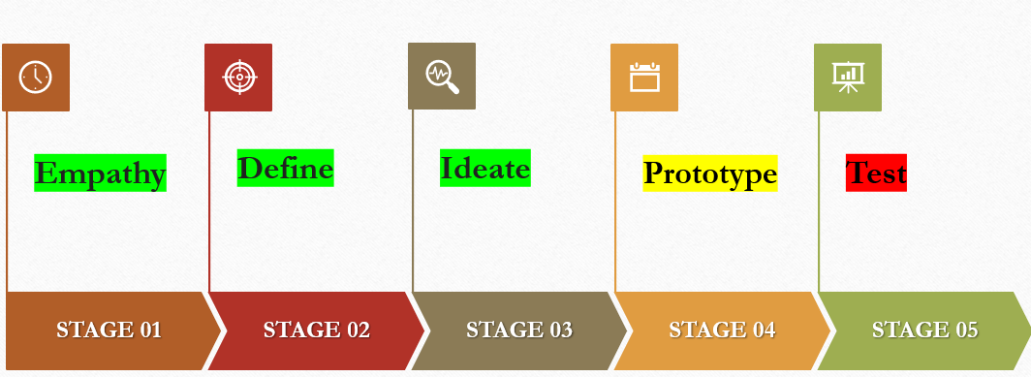
Project Timeline
We are currently in the fourth stage of the Project Timeline which includes the Prototyping & Building the prototype that Students and Faculties will use in the scenario of a Classroom & have developed an App from Scratch for the purpose.

Slide 14
Android Application- Revamp
We have built an Android App to Control and Monitor the Status of Devices, Get Real-time Data and Monitor Students activities right from the App, no matter the Physical Location of the User.
The App is designed and developed using Modern and Widely used technologies like Figma, Java and XML.
We have integrated User-Authentication System using Google Firebase to ensure the security and Privacy of the data.
Thanks to Aditya Singh (CSE-DS)

Slide 15
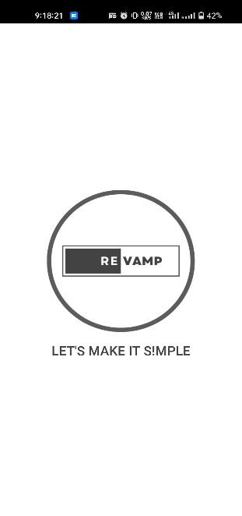
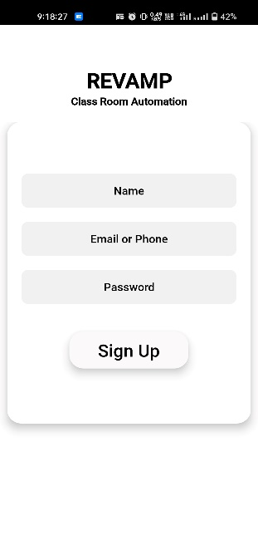
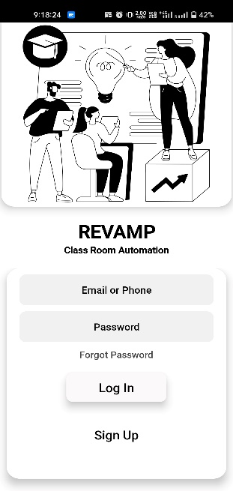
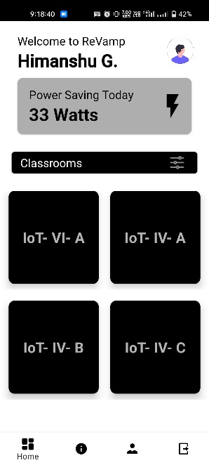
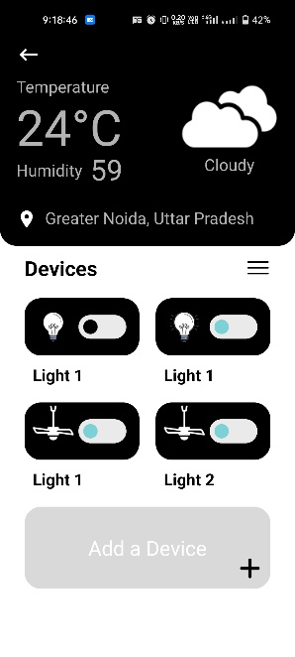
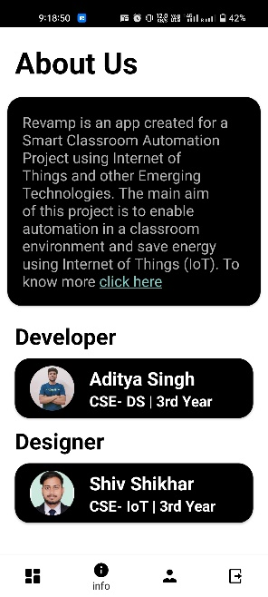
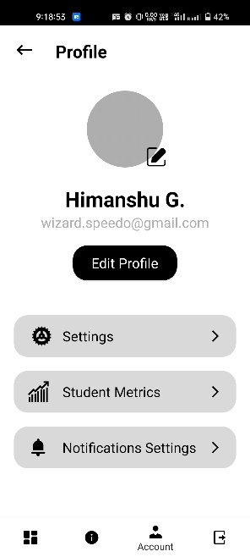
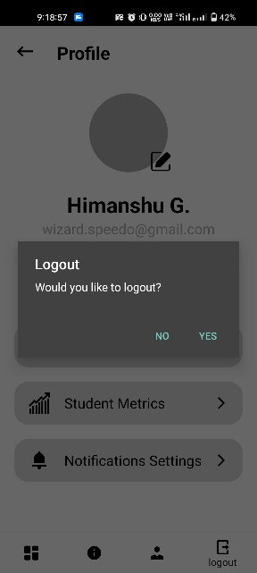
Screenshots of the App- Revamp
Starting Window
Login Page
Sign Up Page
Dashboard
Classroom
About
Profile
Log Out
Thanks to Aditya Singh (CSE-DS)

Slide 16
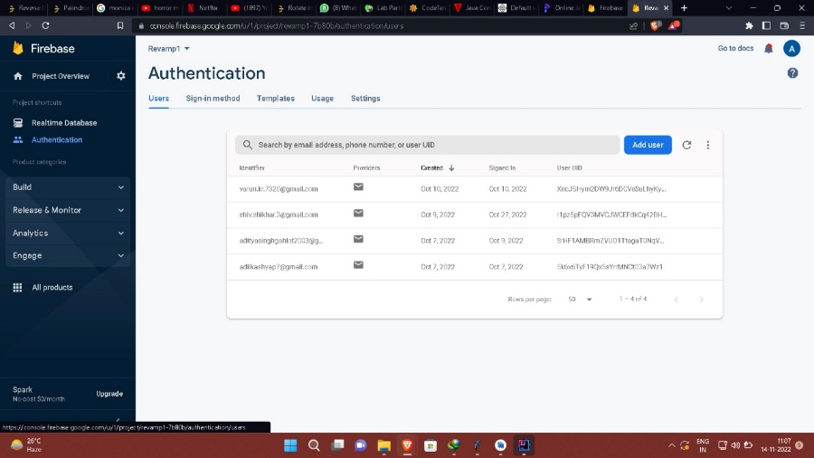
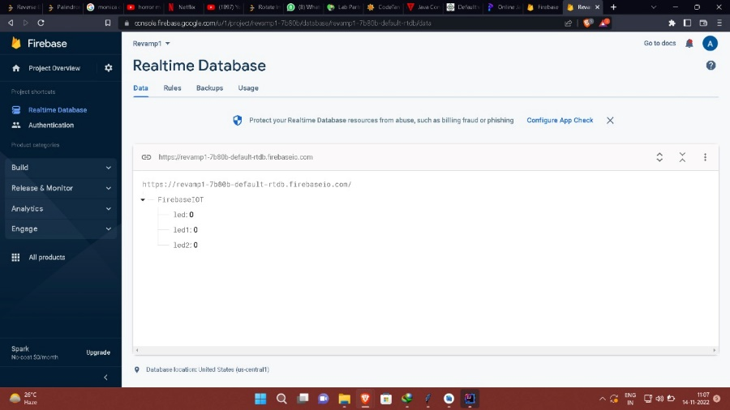
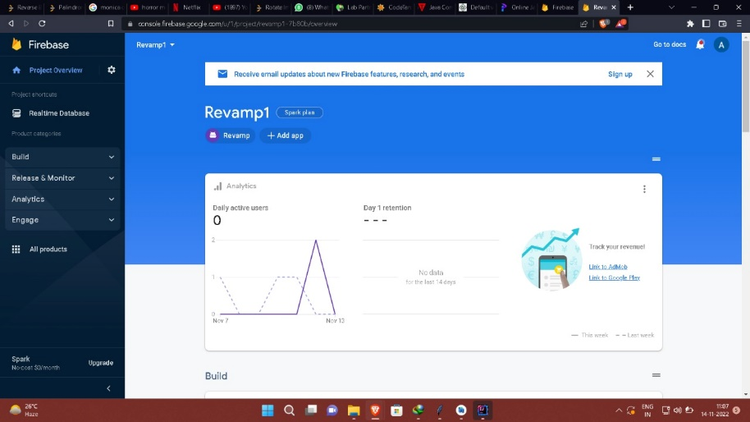
Google Firebase – Realtime Database
We have used Google Firebase in the backend for managing the data coming from sensor and sending it to the App and vice-versa.
We have integrated user-authentication via Firebase.
We can add multiple extensions as per any other use-case.

Slide 17
FUTURE ACTION PLAN
To Add Power Saving Insights
To Add multiple Classrooms in the app to control and monitor.
To Add appliances like Projector etc manually.
To Monitor Students Activities in a Classroom.

Slide 18
References
https://www.javatpoint.com/iot-project-google-firebase-controlling-led-using-android-app
https://www.techtarget.com/iotagenda/feature/How-to-use-Google-Firebase-to-build-real-time-IoT-apps

Slide 19
Thank You

Slide 20
Feedback from the Panel
The panel wants the team to :

